Slide 1
K-Nearest-Neighbors Algorithm and Its Application

Slide 2
K-Nearest-Neighbors Algorithm
K nearest neighbors (KNN) is a simple algorithm that stores all available cases and classifies new cases based on a similarity measure (distance function)
KNN has been used in statistical estimation and pattern recognition since 1970’s.

Slide 3
K-Nearest-Neighbors Algorithm
A case is classified by a majority voting of its neighbors, with the case being assigned to the class most common among its K nearest neighbors measured by a distance function.
If K=1, then the case is simply assigned to the class of its nearest neighbor

Slide 4
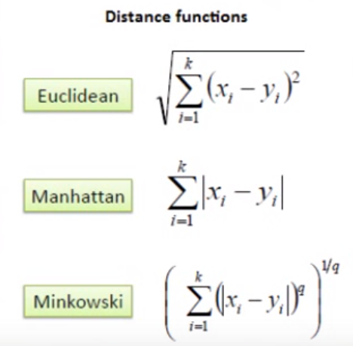
Distance Function Measurements

Slide 5
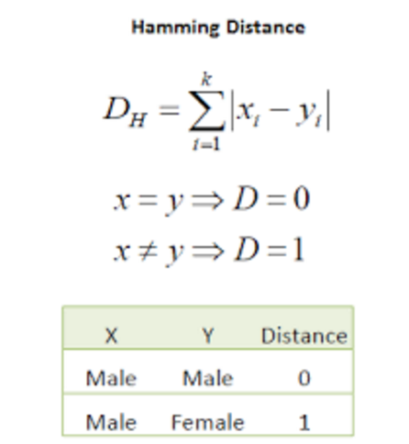
Hamming Distance
For category variables, Hamming distance can be used.

Slide 6
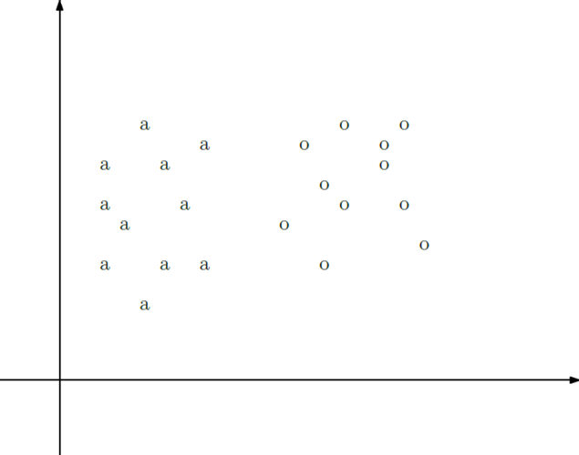
K-Nearest-Neighbors

Slide 7
What is the most possible label for c?
c

Slide 8
What is the most possible label for c?
Solution: Looking for the nearest K neighbors of c.
Take the majority label as c’s label
Let’s suppose k = 3:

Slide 9
What is the most possible label for c?
c

Slide 10
What is the most possible label for c?
The 3 nearest points to c are: a, a and o.
Therefore, the most possible label for c is a.

Slide 11
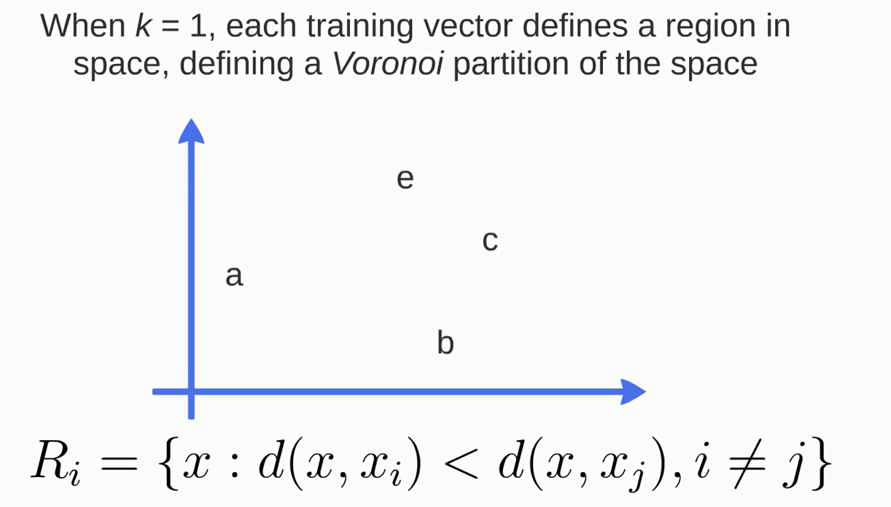
Voronoi Diagram

Slide 12
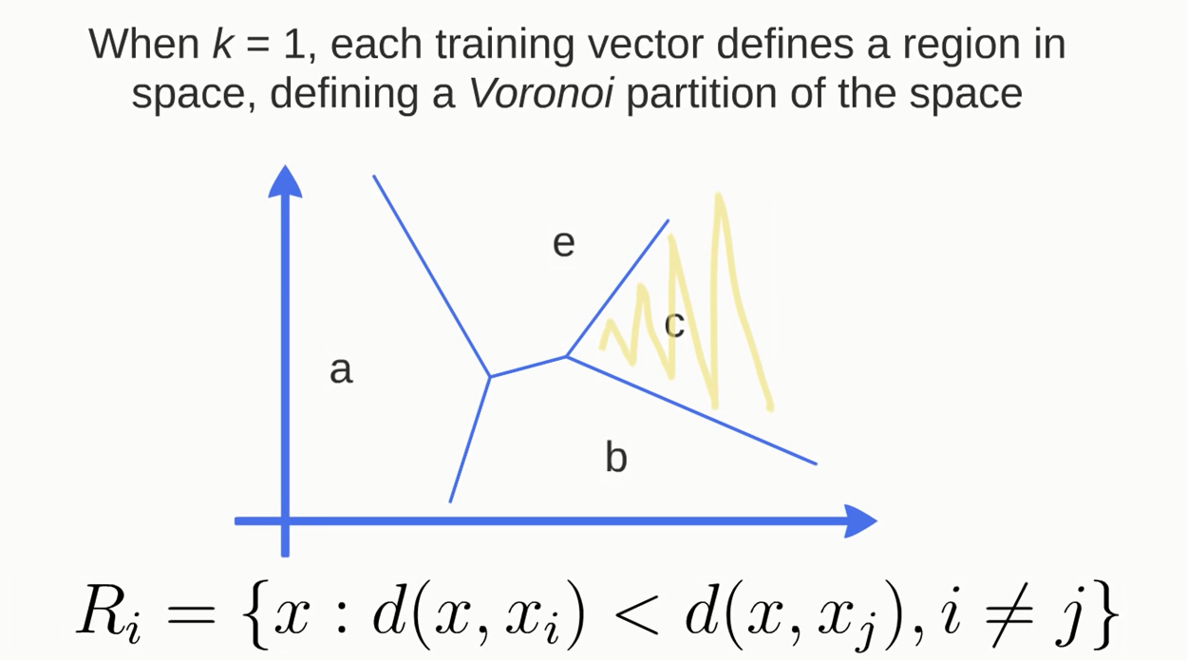
Voronoi Diagram

Slide 13
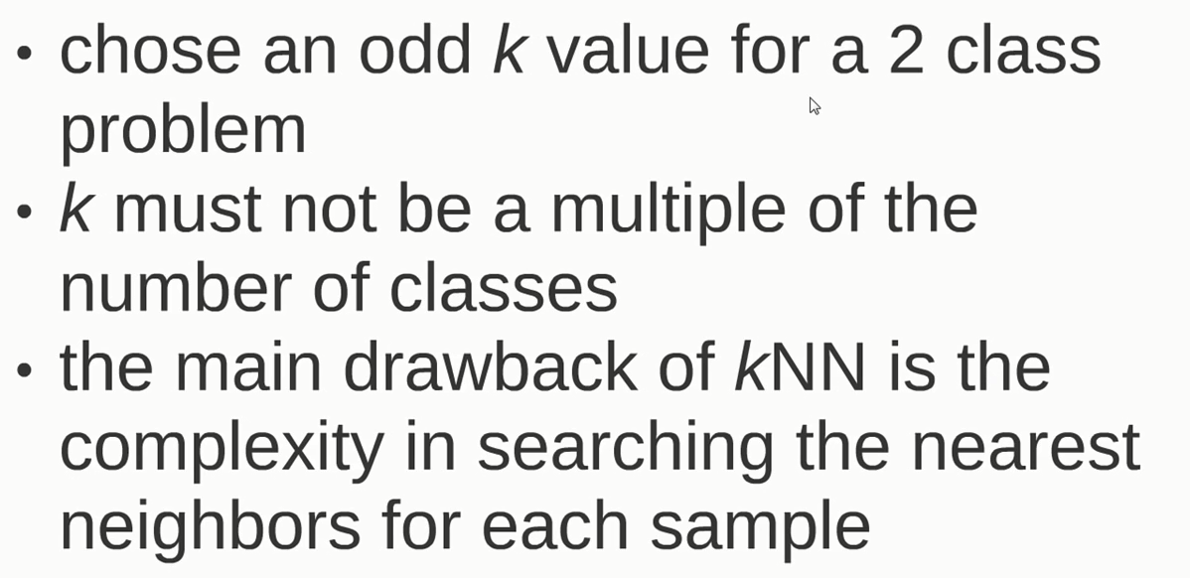
Remarks

Slide 14
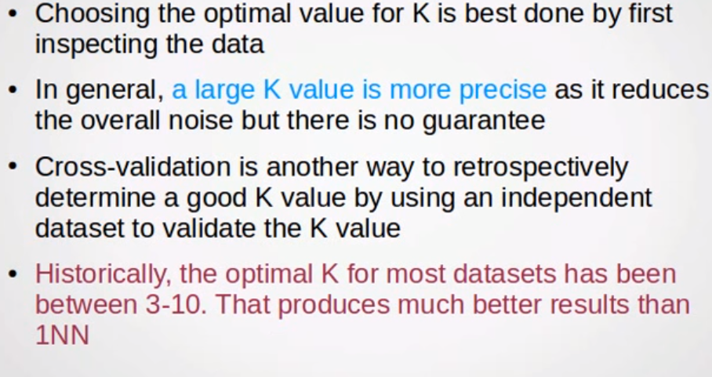
Choosing the most suitable K

Slide 15
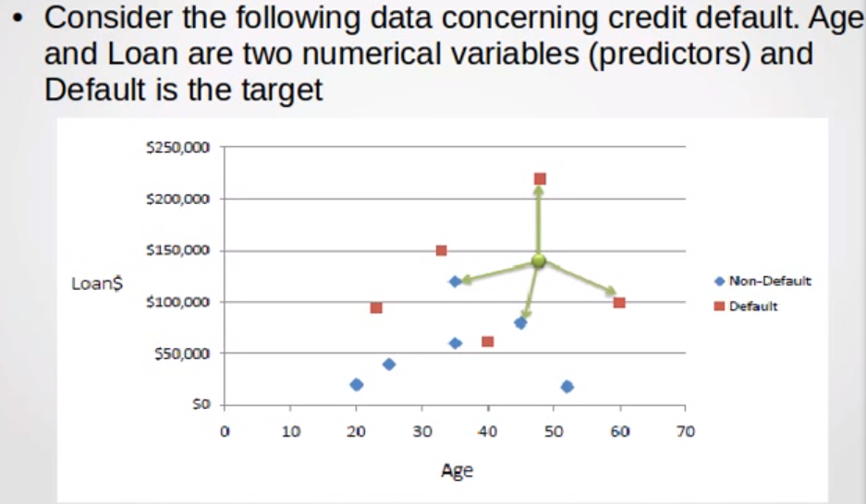
Normalization

Slide 16
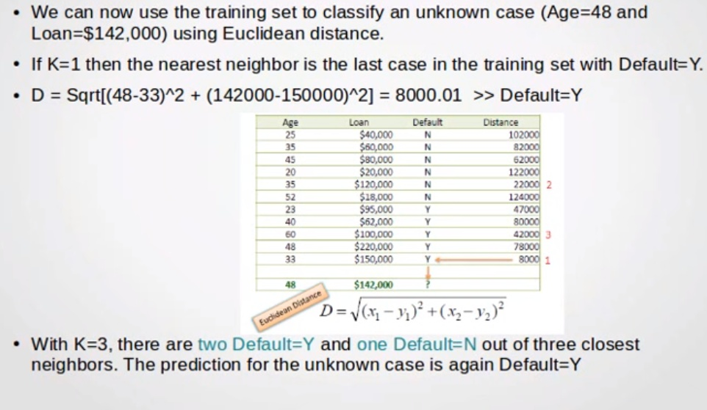
Normalization

Slide 17
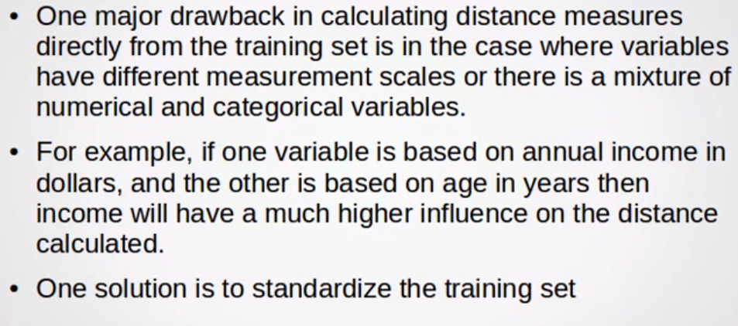
Normalization

Slide 18
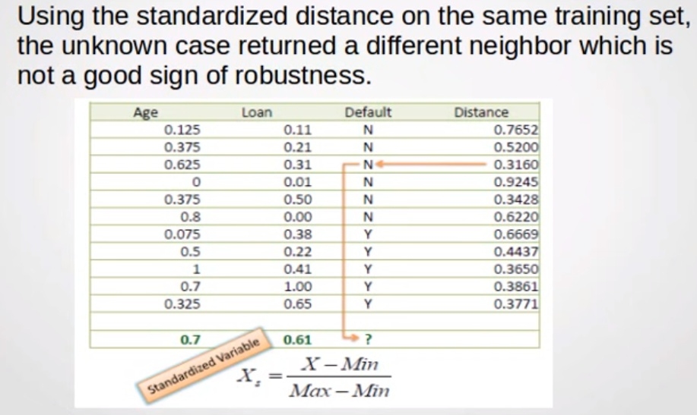
Normalization

Slide 19
k-Nearest Neighbor Classification (kNN)
Unlike all the previous learning methods, kNN does not build model from the training data.
To classify a test instance d, define k-neighborhood P as k nearest neighbors of d
Count number n of training instances in P that belong to class c_{j}
Estimate Pr(c_{j}|d) as n/k
No training is needed. Classification time is linear in training set size for each test case.

Slide 20
Discussions
kNN can deal with complex and arbitrary decision boundaries.
Despite its simplicity, researchers have shown that the classification accuracy of kNN can be quite strong and in many cases as accurate as those elaborated methods.
kNN is slow at the classification time
kNN does not produce an understandable model

Slide 21
K- Means

Slide 22
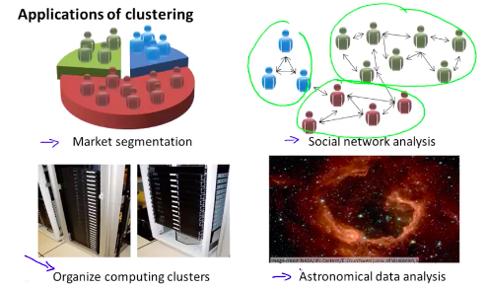
Clustering
Learning from unlabelled data
Unsupervised learning
Useful to contrast with supervised learning
Compare and contrast
Supervised learning
Given a set of labels, fit a hypothesis to it
Unsupervised learning
Try and determining structure in the data
Clustering algorithm groups data together based on data features
What is clustering good for
Market segmentation - group customers into different market segments
Social network analysis - Facebook "smartlists"
Organizing computer clusters and data centers for network layout and location
Astronomical data analysis - Understanding galaxy formation

Slide 23
K-means algorithm
An algorithm to automatically group the data into coherent clusters
K-means is by far the most widely used clustering algorithm
Take unlabelled data and group into two clusters

Slide 24
Algorithm overview
1) Randomly allocate two points as the cluster centroids
Have as many cluster centroids as clusters you want to do (K cluster centroids, in fact)
In our example we just have two clusters
2) Cluster assignment step
Go through each example and depending on if it's closer to the red or blue centroid assign each point to one of the two clusters
To demonstrate this, we've gone through the data and "colour" each point red or blue

Slide 25
3) Move centroid step Take each centroid and move to the average of the correspondingly assigned data-points
Repeat 2) and 3) until convergence

Slide 26
Formal Definition
Input:
K (number of clusters in the data)
Training set {x¹, x², x³ ..., x^{n})
Algorithm:
Randomly initialize K cluster centroids as {μ₁, μ₂, μ₃ ... μ_{K}}

Slide 27
Loop 1
This inner loop repeatedly sets the c^{(i)} variable to be the index of the closes variable of cluster centroid closes to x^{i}
i.e. take i^{th} example, measure squared distance to each cluster centroid, assign c^{(i)}to the cluster closest
Loop 2
Loops over each centroid calculate the average mean based on all the points associated with each centroid from c^{(i)}
What if there's a centroid with no data
Remove that centroid, so end up with K-1 classes
Or, randomly reinitialize it
Not sure when though...

Slide 28
K-means for non-separated clusters
So far looking at K-means where we have well defined clusters
But often K-means is applied to datasets where there aren't well defined clusters
e.g. T-shirt sizing

Slide 29
Not obvious discrete groups
Say you want to have three sizes (S,M,L) how big do you make these?
One way would be to run K-means on this data
May do the following
So creates three clusters, even though they aren't really there
Look at first population of people
Try and design a small T-shirt which fits the 1st population
And so on for the other two
This is an example of market segmentation
Build products which suit the needs of your subpopulations

Slide 30
K means optimization objective
Supervised learning algorithms have an optimization objective (cost function)
K-means does too
K-means has an optimization objective like the supervised learning functions we've seen
Why is this good?
Knowing this is useful because it helps for debugging
Helps find better clusters

Slide 31
While K-means is running we keep track of two sets of variables
c^{i} is the index of clusters {1,2, ..., K} to which x^{i} is currently assigned
i.e. there are m c^{i} values, as each example has a c^{i} value, and that value is one the the clusters (i.e. can only be one of K different values)
μ_{k}, is the cluster associated with centroid k
Locations of cluster centroid k
So there are K
So these the centroids which exist in the training data space
μ_{c}^{i}, is the cluster centroid of the cluster to which example x^{i} has been assigned to
This is more for convenience than anything else
You could look up that example i is indexed to cluster j (using the c vector), where j is between 1 and K
Then look up the value associated with cluster j in the μ vector (i.e. what are the features associated with μ_{j})
But instead, for easy description, we have this variable which gets exactly the same value
Lets say x^{i} as been assigned to cluster 5
Means that
c^{i} = 5
μ_{c}^{i}, = μ₅

Slide 32
Using this notation we can write the optimization objective;
i.e. squared distances between training example x^{i} and the cluster centroid to which x^{i} has been assigned to. This is just what we've been doing, as the visual description below shows;
The red line here shows the distances between the example x^{i} and the cluster to which that example has been assigned
Means that when the example is very close to the cluster, this value is small
When the cluster is very far away from the example, the value is large
This is sometimes called the distortion (or distortion cost function)
So we are finding the values which minimizes this function;

Slide 33
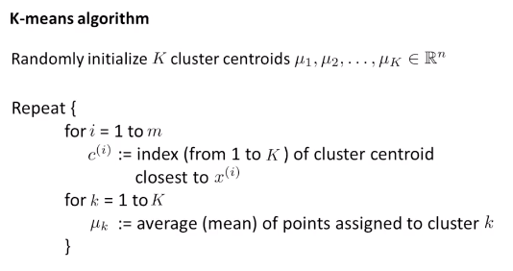
If we consider the k-means algorithm
The cluster assigned step is minimizing J(...) with respect to c¹, c² ... c^{i}
i.e. find the centroid closest to each example
Doesn't change the centroids themselves
The move centroid step
We can show this step is choosing the values of μ which minimizes J(...) with respect to μ
So, we're partitioning the algorithm into two parts
First part minimizes the c variables
Second part minimizes the J variables
We can use this knowledge to help debug our K-means algorithm

Slide 34
Random initialization
How we initialize K-means
And how avoid local optimum
Consider clustering algorithm
Never spoke about how we initialize the centroids
A few ways - one method is most recommended
Have number of centroids set to less than number of examples (K < m) (if K > m we have a problem)
Randomly pick K training examples
Set μ₁ up to μ_{K} to these example's values
K means can converge to different solutions depending on the initialization setup
Risk of local optimum
The local optimum are valid convergence, but local optimum not global ones
If this is a concern
We can do multiple random initializations
See if we get the same result - many same results are likely to indicate a global optimum

Slide 35
Algorithmically we can do this as follows;
A typical number of times to initialize K-means is 50-1000
Randomly initialize K-means
For each 100 random initialization run K-means
Then compute the distortion on the set of cluster assignments and centroids at convergent
End with 100 ways of cluster the data
Pick the clustering which gave the lowest distortion
If you're running K means with 2-10 clusters can help find better global optimum
If K is larger than 10, then multiple random initializations are less likely to be necessary
First solution is probably good enough (better granularity of clustering)

Slide 36
How do we choose the number of clusters?
Choosing K?
Not a great way to do this automatically
Normally use visualizations to do it manually
What are the intuitions regarding the data?
Why is this hard
Sometimes very ambiguous
e.g. two clusters or four clusters
Not necessarily a correct answer
This is why doing it automatic this is hard

Slide 37
Elbow method
Vary K and compute cost function at a range of K values
As K increases J(...) minimum value should decrease (i.e. you decrease the granularity so centroids can better optimize)
Plot this (K vs J())
Look for the "elbow" on the graph
Chose the "elbow" number of clusters
If you get a nice plot this is a reasonable way of choosing K
Risks
Normally you don't get a a nice line -> no clear elbow on curve
Not really that helpful

Slide 38
Another method for choosing K
Using K-means for market segmentation
Running K-means for a later/downstream purpose
See how well different number of clusters serve you later needs
e.g.
T-shirt size example
If you have three sizes (S,M,L)
Or five sizes (XS, S, M, L, XL)
Run K means where K = 3 and K = 5
How does this look
This gives a way to chose the number of clusters
Could consider the cost of making extra sizes vs. how well distributed the products are
How important are those sizes though? (e.g. more sizes might make the customers happier)
So applied problem may help guide the number of clusters
Classification problems
Email -> spam/not spam?
Online transactions -> fraudulent?
Tumor -> Malignant/benign

